Slide 1
Adversarial ML Workshop
By JankhJankh
JankhJankh
Adversarial ML Workshop

Slide 2
Ground Rules
Everyone has their own docker container so you can do what you want with it.
Each challenge works in a vacuum except Theft3 which should be done after getting code exec in another challenge. (Although I have provided a work around for Theft3 if you can’t get code exec but want to try it.
Source code is provided with redactions, even after getting code execution, avoid looking at the source code for other challenges
If a file can’t be found in the provided source code or html code, you aren’t supposed to find it ;)
If you need to guess a password use Rockyou.

Slide 3
Theory you may need
How Classification Models Work
How a Neural Network Works
Machine Learning Threat Model
MITRE Adversarial Machine Learning Threat Matrix
Tokenizers
Evasion Attacks
Data Poisoning
Model Salting
Multiple Assessment Functions

Slide 4
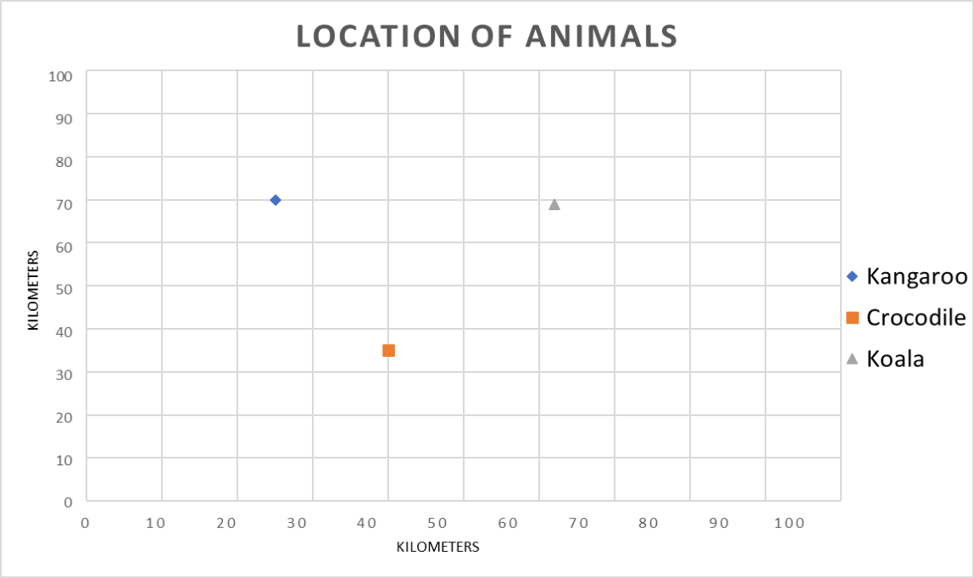
How Classification Models Work
Notes:
So, before we go over some AI attacks. Lets start by talking about how AI works.
We will use 2 Dimensional data to start with as its easier to look at.

Slide 5
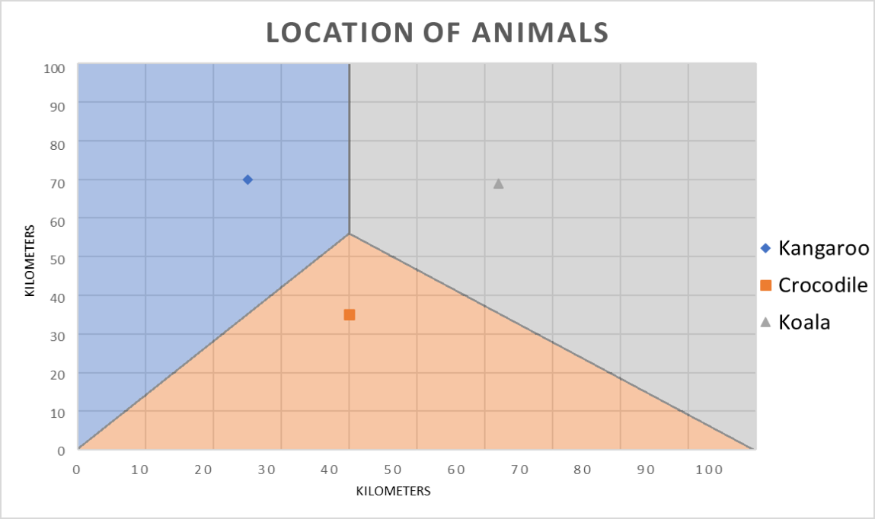
How Classification Models Work
Notes:
By building these lines we have created a model.

Slide 6
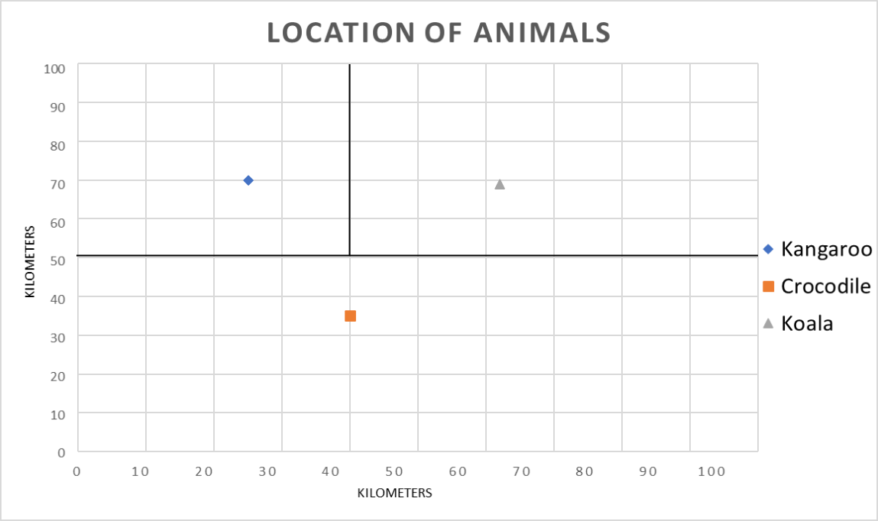
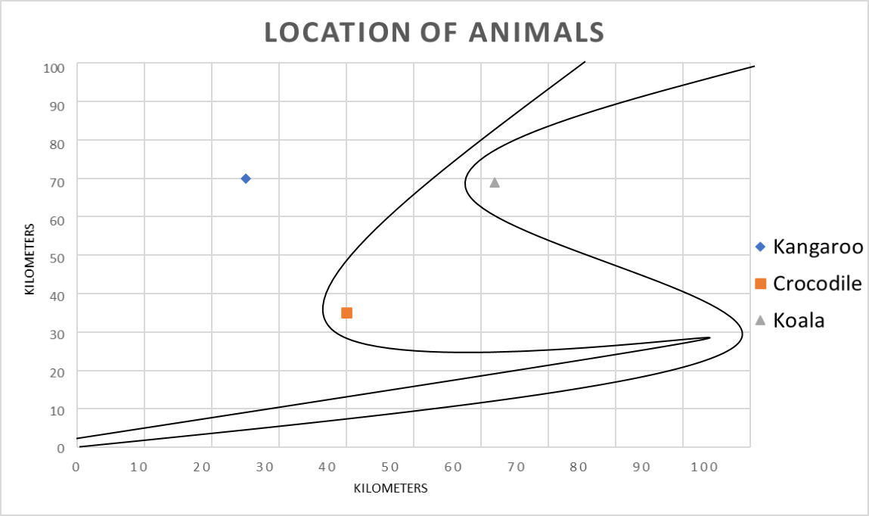
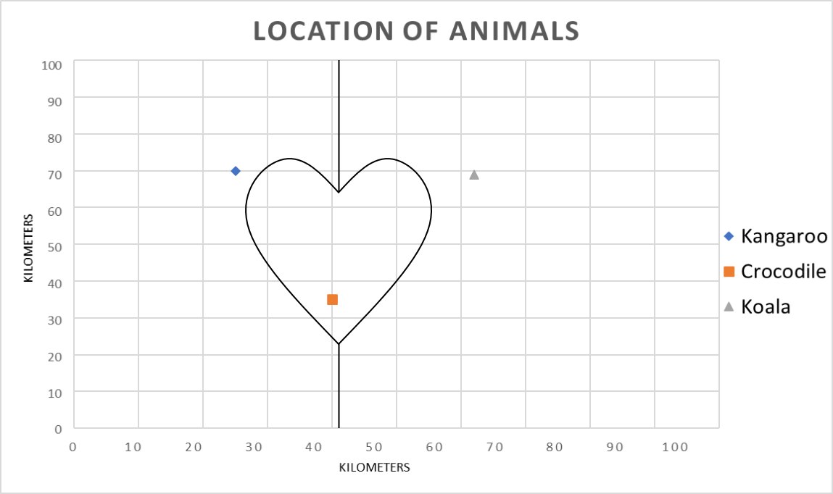
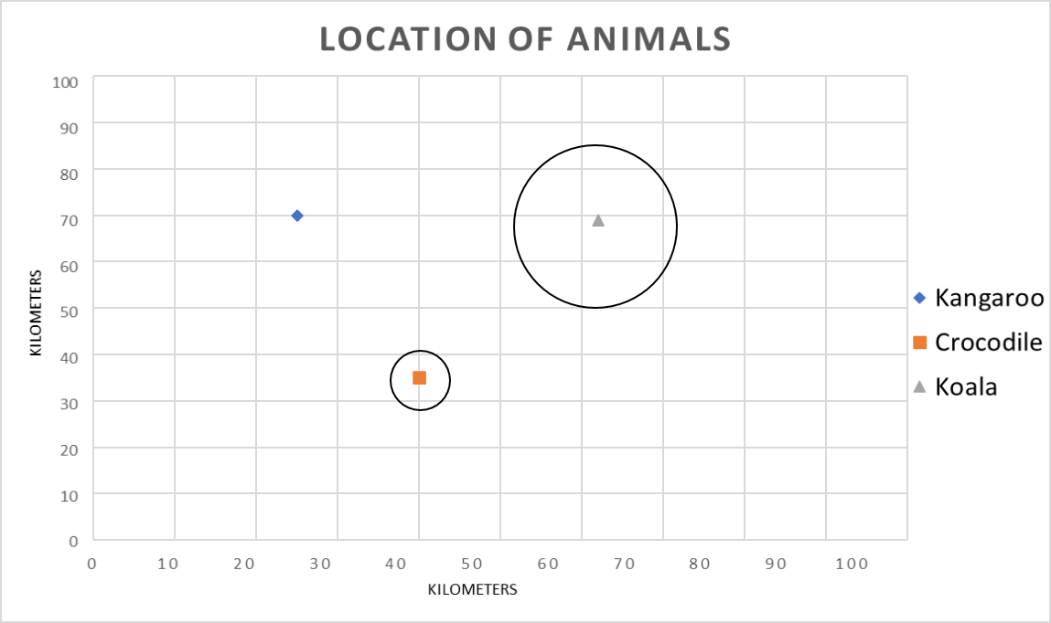
How Classification Models Work

Slide 7
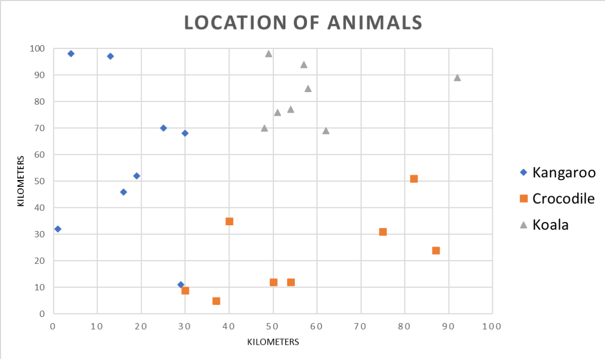
How Classification Models Work

Slide 8
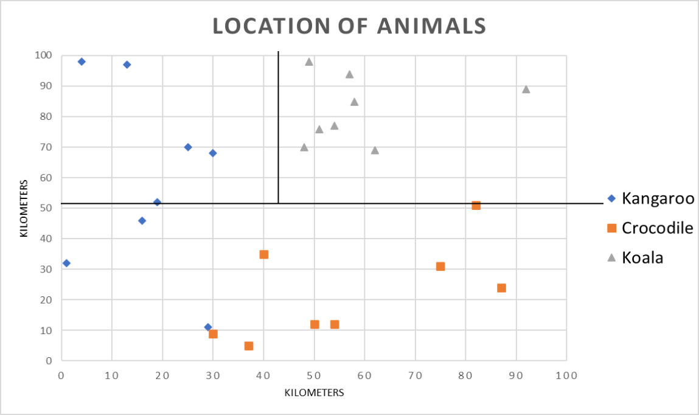
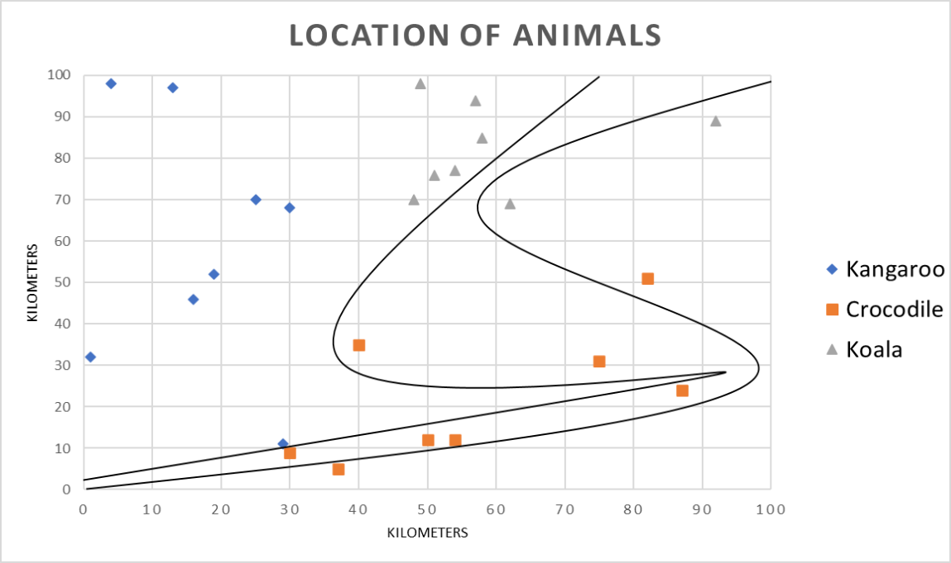
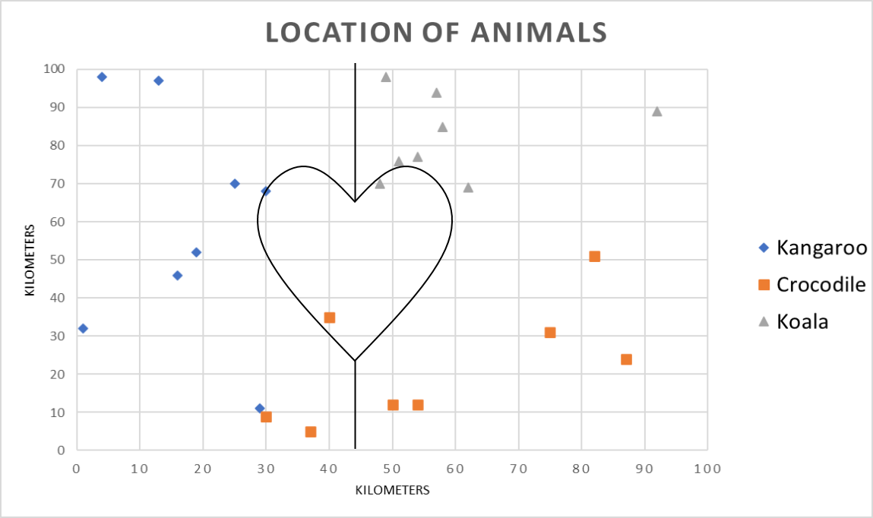
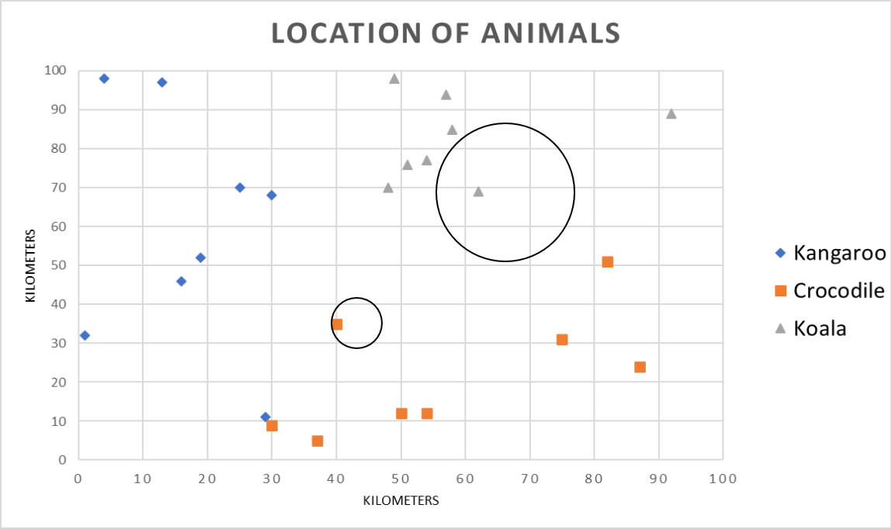
How Classification Models Work

Slide 9

How Classification Models Work

Slide 10
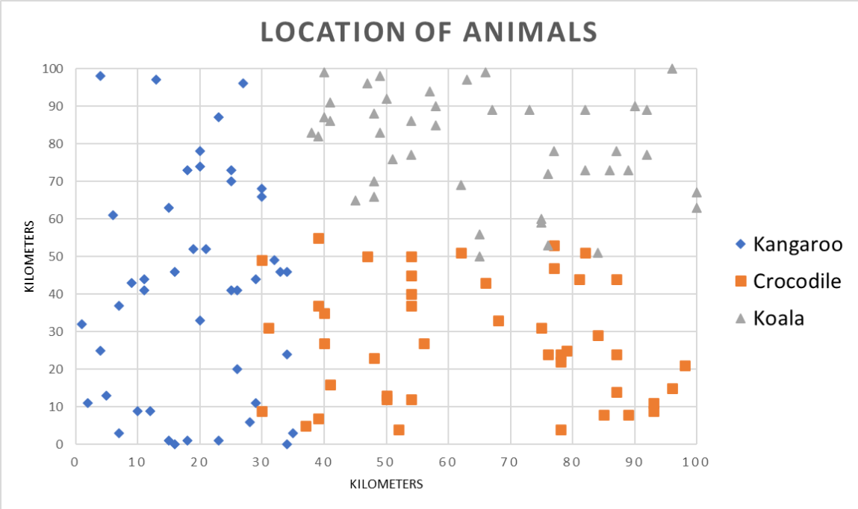
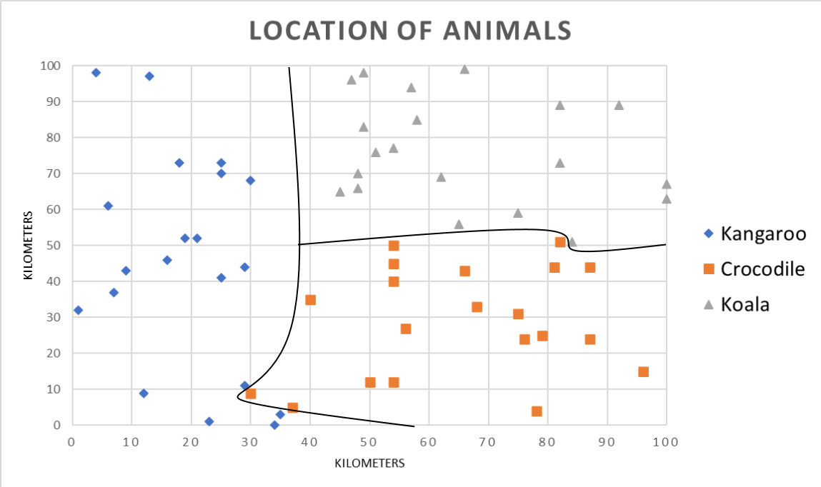
How Classification Models Work
More Data = Better models

Slide 11
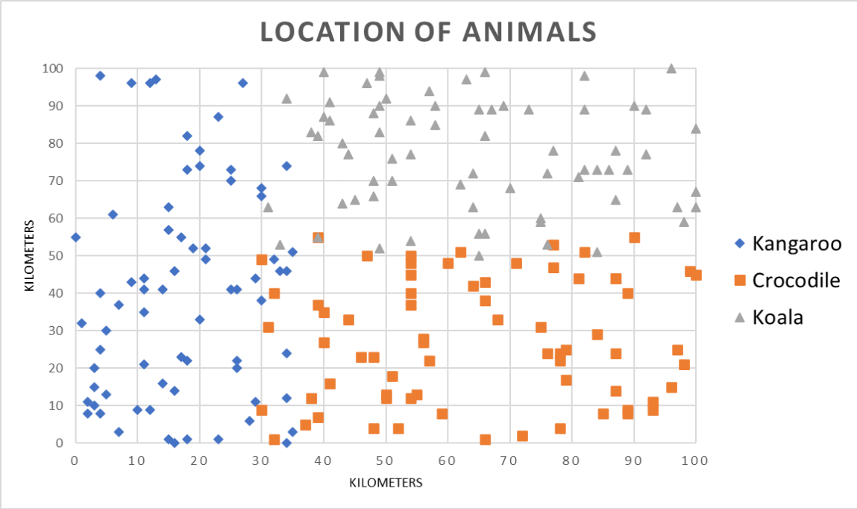
How Classification Models Work

Slide 12
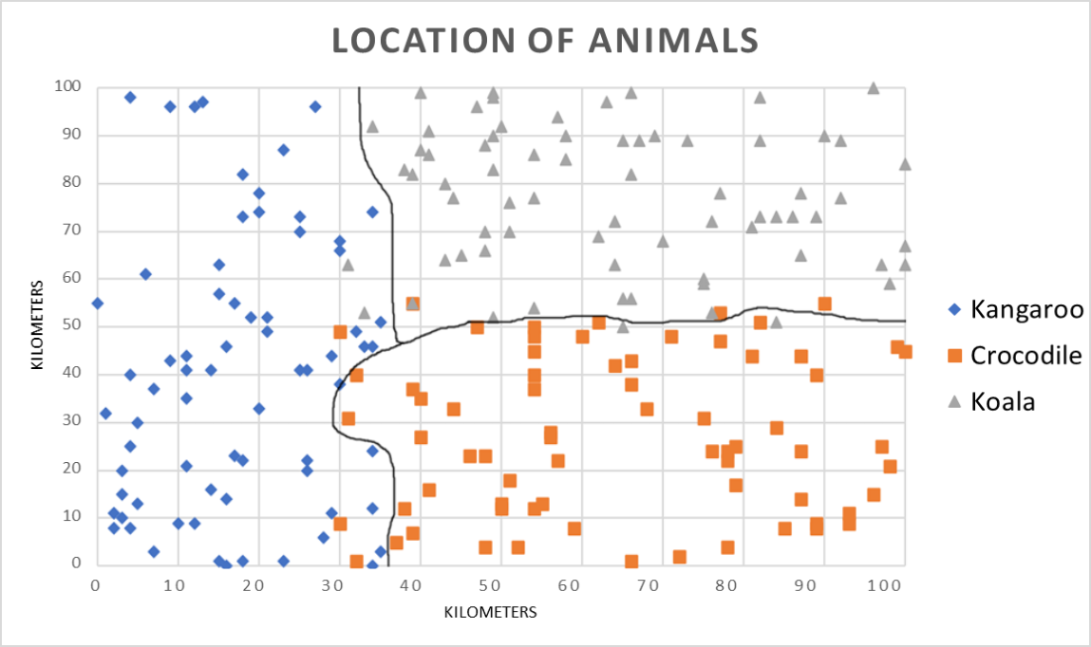
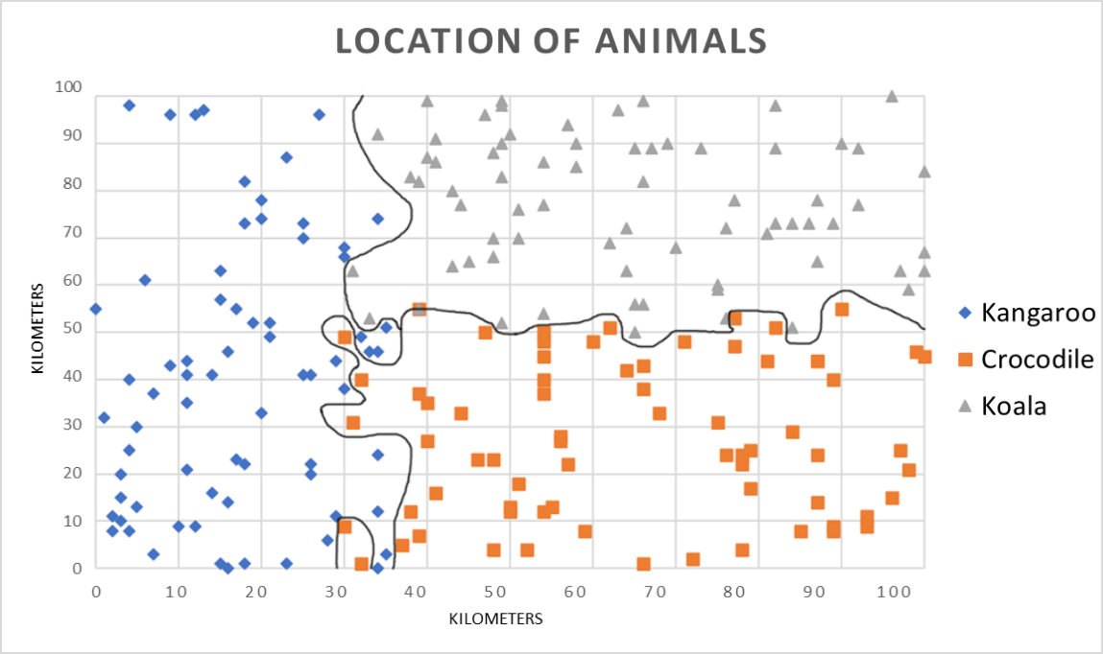
How Classification Models Work
80% Accuracy
100% Accuracy
Which of these models is better?

Slide 13
How Classification Models Work
80% Accuracy
100% Accuracy (Overtrained)
As 80% is better than 100% as it is more general.
Modelling for generalisation is inherently inaccurate to an extent

Slide 14
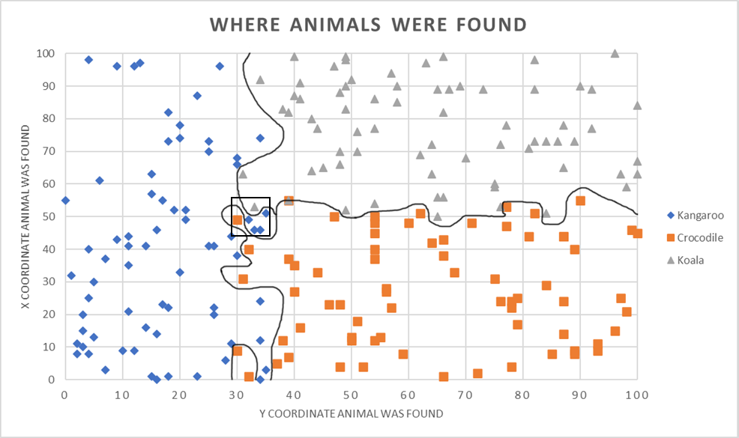

How Classification Models Work
In an overtrained network, little changes in a datapoint can make all the difference in classification.
X | Y | Class
32 | 50 | Kangaroo
30 | 50 | Crocodile
33 | 54 | Koala

Slide 15
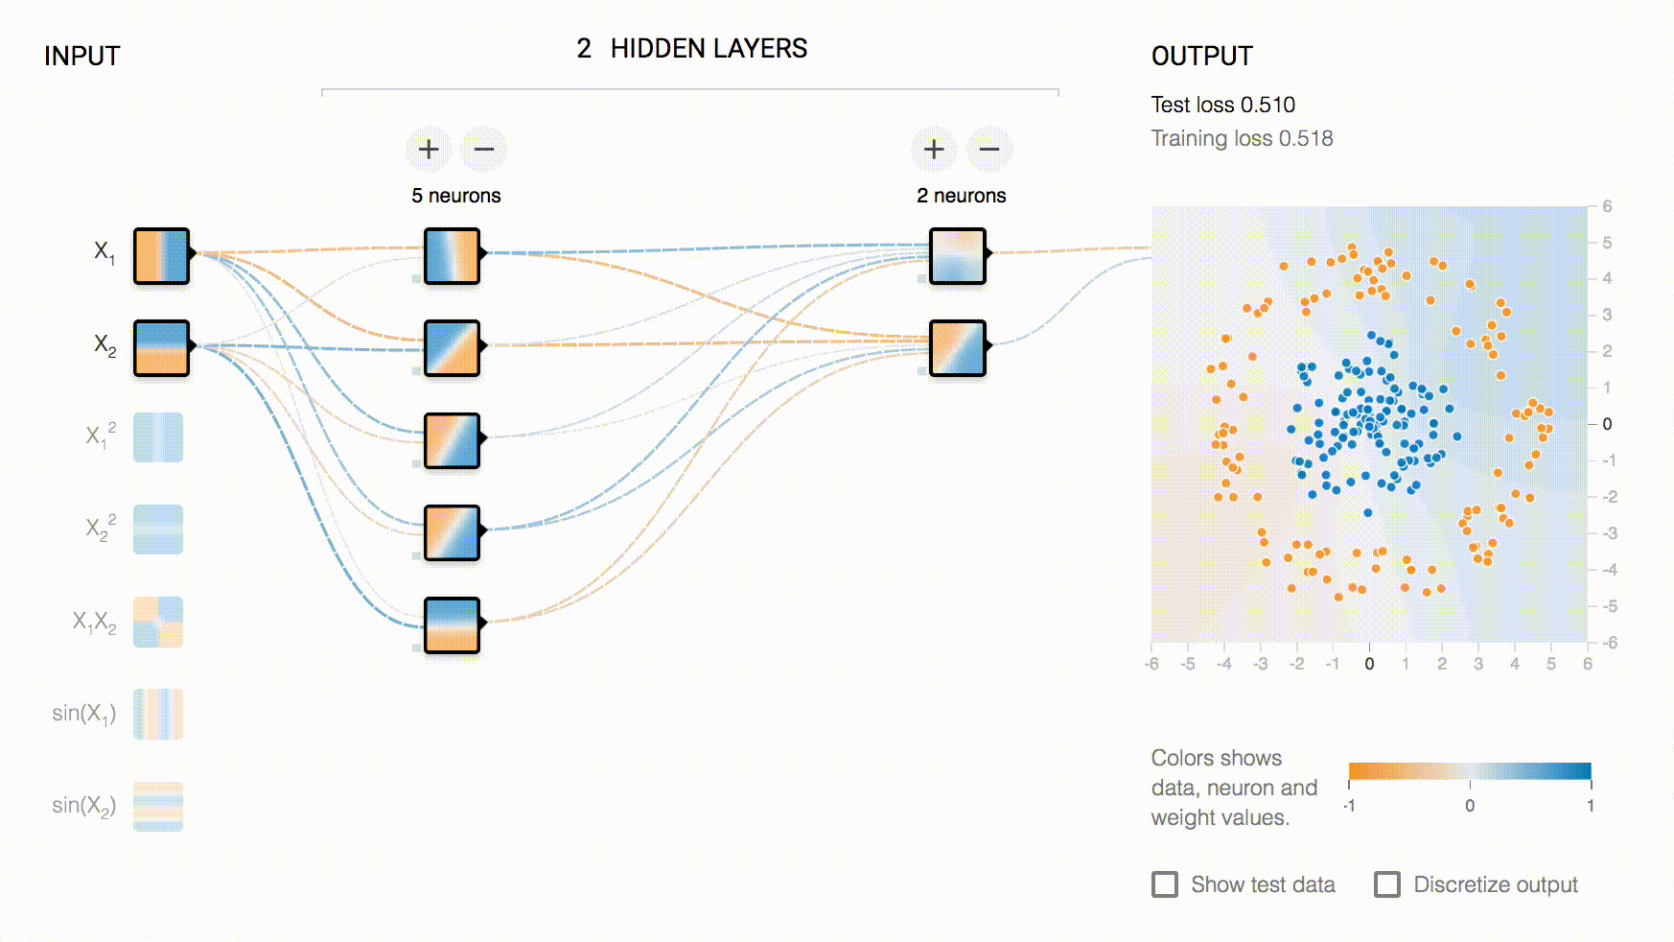
How A Neural Network Works
Fig. 4.
Notes:
The lesson to take away from this is how it improves over time.

Slide 16
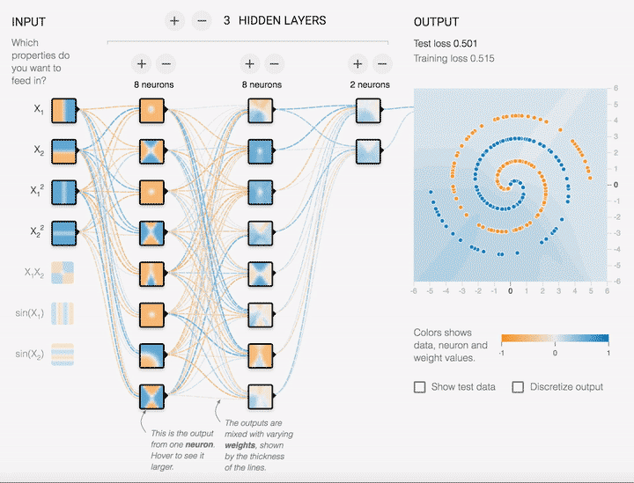
How A Neural Network Works
Fig. 5.

Slide 17
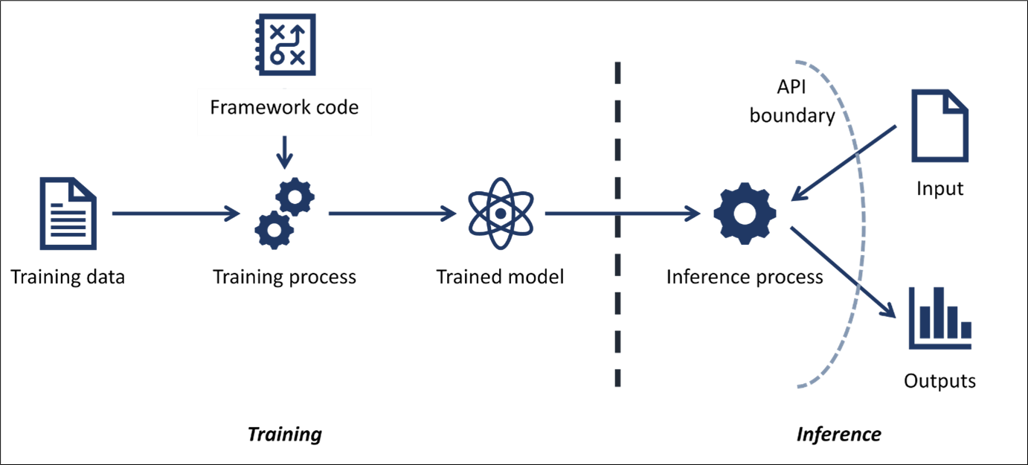
The Machine Learning Threat Model
Fig. 6.
Whatever parts of this model users are interacting with are at risk
Notes:
These attacks are split into two sections. Training and Inference. Training is anything while the model is still learning. Inference is when interacting with the trained model.

Slide 18
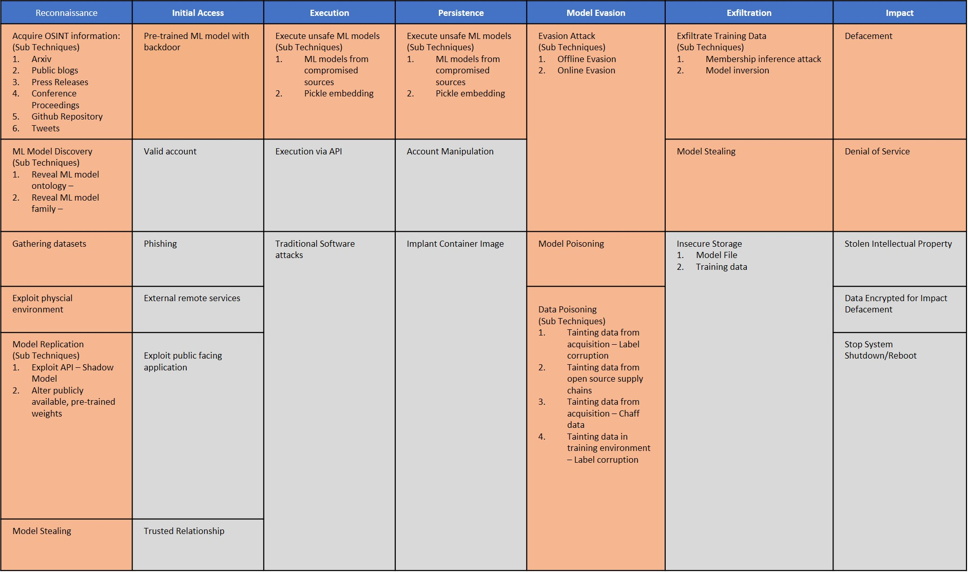
MITRE Adversarial Machine Learning Threat Matrix
Fig. 12.
Notes:
Anyone who knows the MITRE ATT&CK framework will be familiar with tables like this.
Microsoft, MITRE and some other organisations got together to go through a bunch of case studies of AI attacks and built this matrix to categorise the different attacks against a AI systems.
They are split up into sections like the Mitre ATT&CK framework. I’m going to be going through each of sections unique to AI attacks.

Slide 19
Tokenizers
To normalize models regardless of data type, tokenizers can be used. Instead of inputting your data into the model you just give each class a token that it relates to. EG:
Kangaroo: 0
Crocodile: 1
Koala: 2
The model doesn’t actually know what these IDs correlate to, so it will ask the tokenizer. This tokenizer needs to be used in both the training and the inference stages and needs to be consistent between both ;)
For the sentiment analysis model in the CTF, it uses a tokenizer to give each word a value, and then evaluates each sentence as a list of IDs, eg: The number after is either a 1 or a 0 corresponding to positive sentiment or negative sentiment.
What a lovely day,1 -> [28,50,19,200]=1 This absolutely sucked,0 -> [1,234,24]=0 This was not lovely,0 -> [1,99,2,13]=0 This was lovely,1 -> [1,99,13]=1

Slide 20

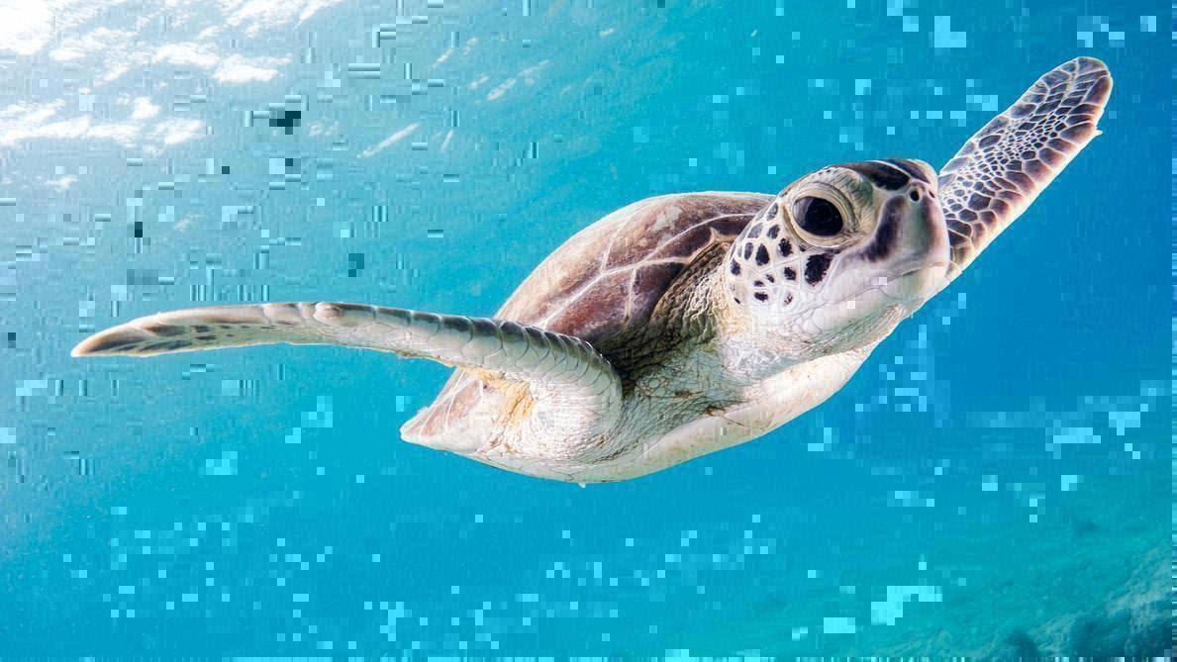

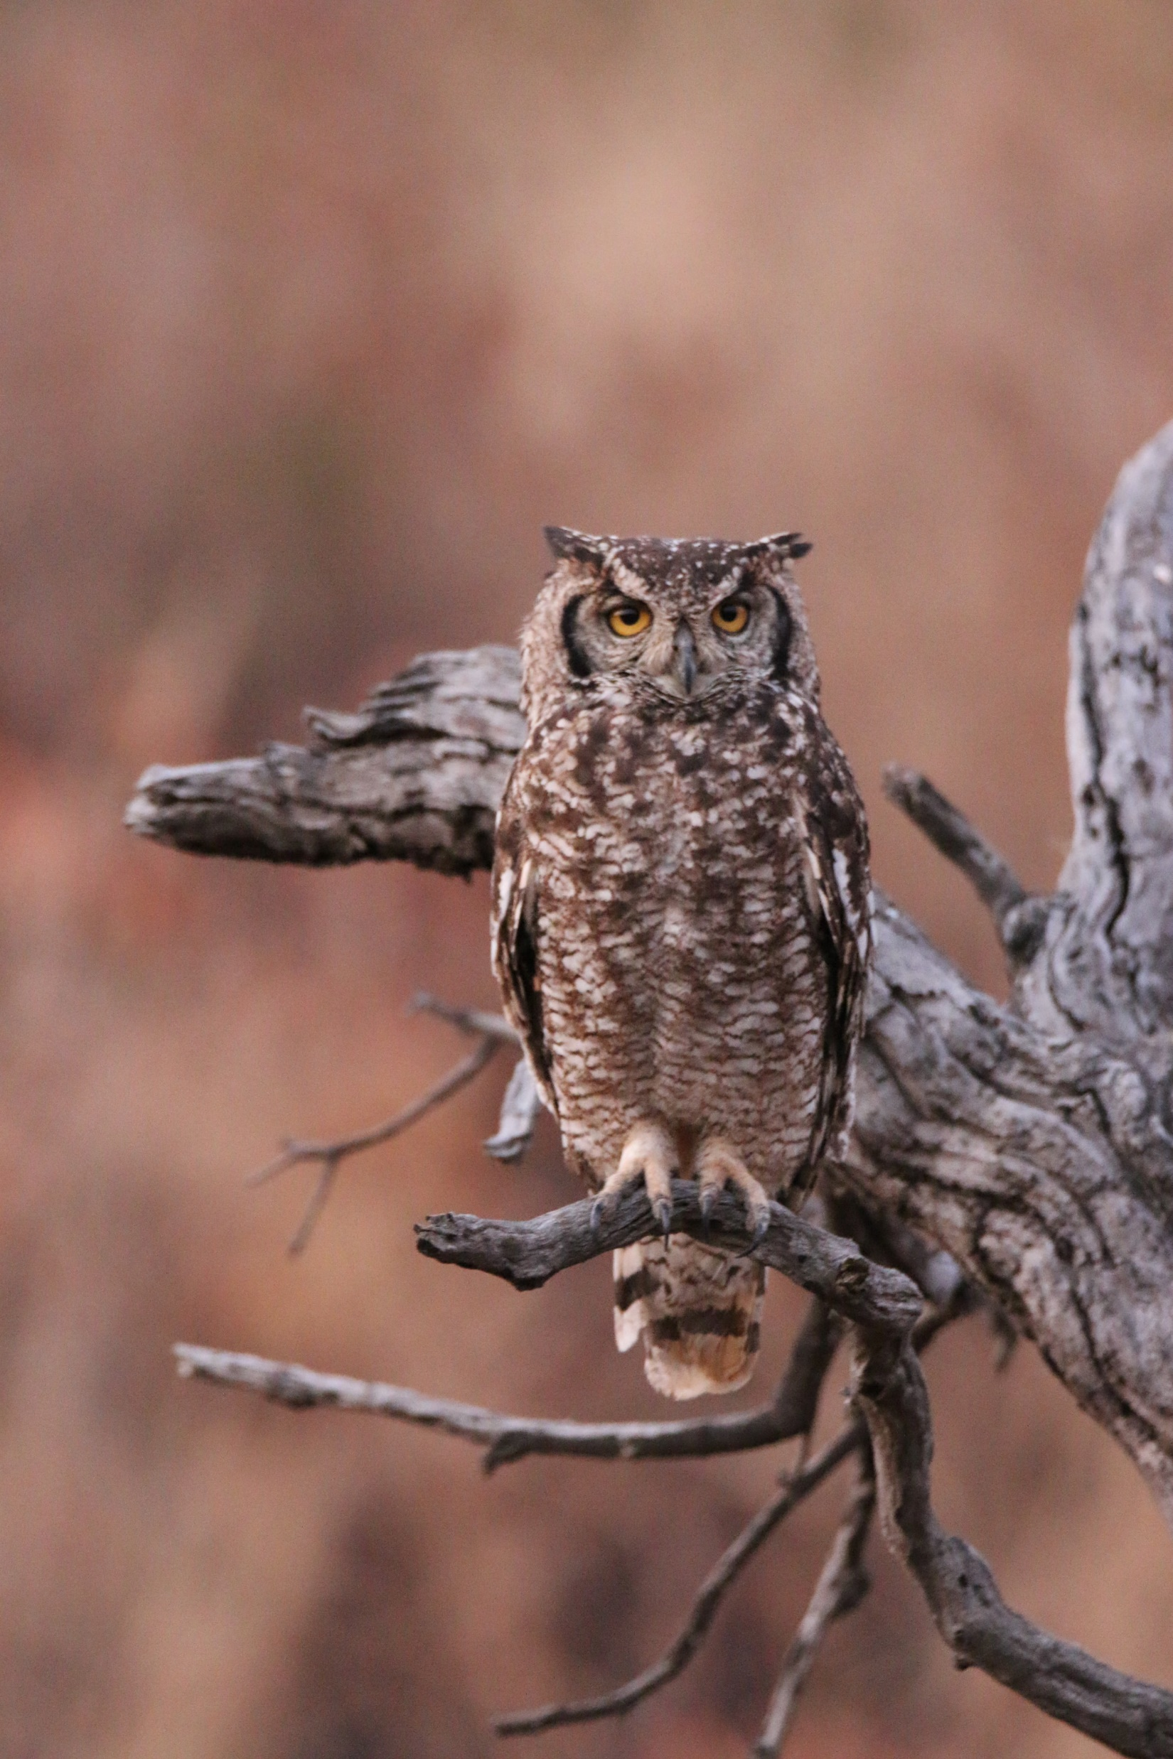
Evasion Attack
My Table of Owls and Turtles
My Classification
Steps to do Adversarial Noise:
Slightly change the image (e.g. by gaussian noise)
Check the image confidence against the model
If it has higher owl confidence it updates current image
Repeat steps 2 and 3 until the model classifies it as the target class
Turtle
Owl
Turtle
Model Classification
Owl
Fig. 20.
Fig. 21.
Notes:
If we have a model, and we want to misclassify an image for some reason, we could do an evasion attack. One easy example of this is adversarial noise.

Slide 21
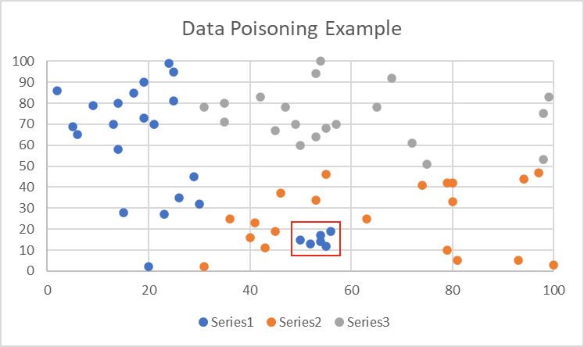
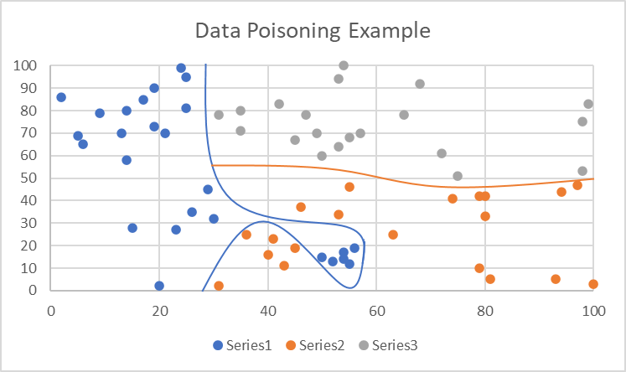
Data Poisoning

Slide 22
Defence: Model Protection
Salts would be a mask put on each image before classification to reduce the risks of noise.
Salt models the way you salt passwords
Salts could be unique per image if they are derived from the image. That way you can gain consistent classification results.
Make sure the salt is unique to each model or trust zone.

Slide 23
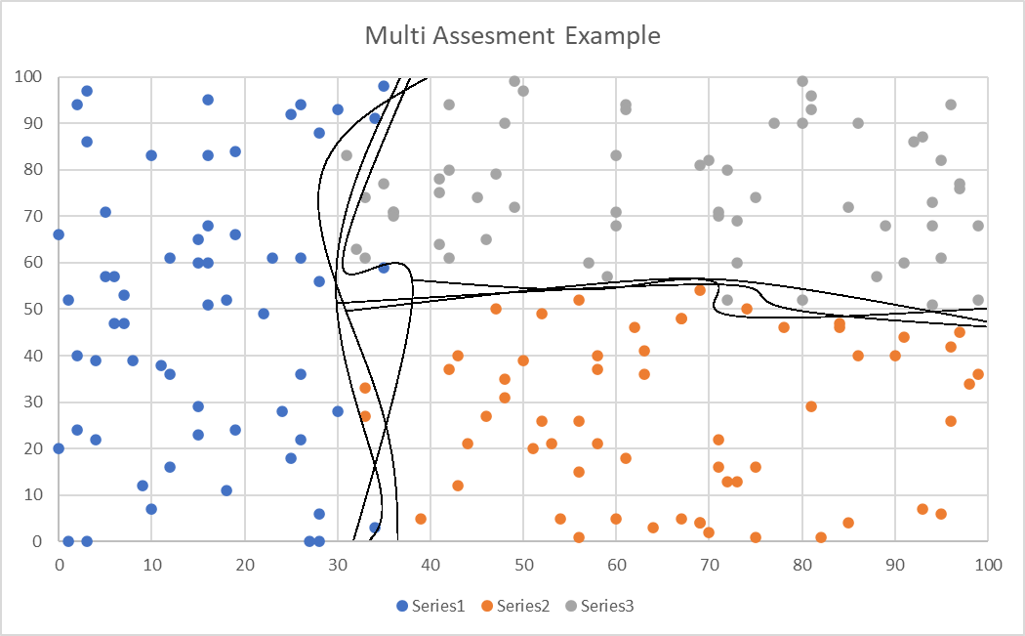
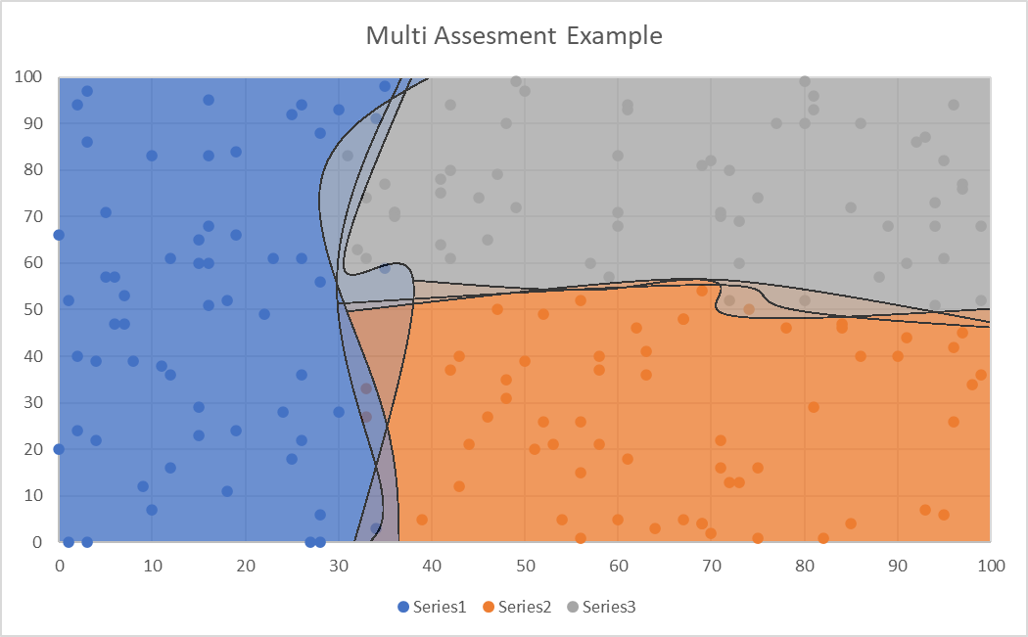
Defence: Multiple Assessment Functions

Slide 24
Challenges ☺
K-Means
Model theft and evasion:
Theft1
Theft2
Theft3
WAF
Model Poisoning:
Poison1
Poison2
Token
Shift
Pickle Uploading
Model Salt Bypass
Salt1
Salt2
Salt3

Slide 25
K-Means
This is a challenge to backdoor a dataset so K-Means clustering will get 100% accuracy or 33% accuracy (The lowest possible with 3 classes)
This is a challenge from an old CTF of mine so it’s a bit clunky, I’d skip it unless you're very curious about unsupervised learning.
Threat model targets:
Trained Model
Inference process (Offline)
Inference process (Online)
MITRE Mapping:
ML Model Discovery
Model Replication
Model Stealing

Slide 26
Theft1
The goal of this challenge is to steal the model to do an offline evasion attack against it.
Sample code is provided in the CNN file. This solution is ready to beat the Google’s CNN Challenge file.
Threat model targets:
Trained Model
Inference process (Offline)
Inference process (Online)
MITRE Mapping:
ML Model Discovery
Model Replication
Offline Evasion
Model Stealing

Slide 27
Theft2
The goal of this challenge is to steal the model to do an offline evasion attack against it. This time the model is encrypted on disk and decrypted at runtime.
Sample code is provided in the CNN file. This solution is ready to beat the Google’s CNN Challenge file.
Threat model targets:
Trained Model
Inference process (Offline)
Inference process (Online)
MITRE Mapping:
ML Model Discovery
Model Replication
Offline Evasion
Model Stealing

Slide 28
Theft3
The goal of this challenge is to steal the model to do an offline evasion attack against it. This time the model is encrypted on disk and decrypted at runtime via a code it retrieves from another server you don’t have access to*.
*This was logistically a hassle to do, but the goal of this challenge is to retrieve the model IF the decryption key was too long to brute force, and you can no longer retrieve a copy of the decryption key. IE the model is only available in memory.
Sample code is provided in the CNN file. This solution is ready to beat the Google’s CNN Challenge file.
Threat model targets:
Trained Model
Inference process (Offline)
Inference process (Online)
MITRE Mapping:
ML Model Discovery
Model Replication
Offline Evasion
Model Stealing

Slide 29
WAF
A ML model has been built to detect a 0-day. This model is used by a WAF to block malicious requests.
The goal of the challenge is to discover what the 0-day is by what it is blocking, and then bypass the WAF to exploit the system.
Threat model targets:
Training Data
Inference process (Online)
MITRE Mapping:
ML Model Discovery
Exfiltrate Training Data
Online Evasion

Slide 30
Poison1
Poison the model to give the string "BEES" over 50% confidence as class 1. (There's only two classes)
User controlled data is marked as class 0, is there any way around this?
Threat model targets:
Training Data
Training Process
Trained Model
Inference Process (Online)
MITRE Mapping:
ML Model Discovery
Data Poisoning – Tainting Data from acquisition, Label Corruption
Defacement

Slide 31
Poison2
Poison the model to give the string "BEES" over 50% confidence as class 1. (There's only two classes)
This is the same as Poison1 but with a couple of changes to make it more secure, is this still vulnerable?
PS: This is an entirely different attack avenue to Poison1
Threat model targets:
Training Data
Training Process
Trained Model
Inference Process (Online)
MITRE Mapping:
ML Model Discovery
Data Poisoning – Tainting Data in training environment, Label Corruption
Denial of Service

Slide 32
Token
to give the string "SECRETSRING" over 80% confidence as class 1. (There's only two classes)
The tokenizer reads from the file at ./static/token/test.csv.
This problem is a little contrived, but it helps a lot as a way to verify you understand how tokenizers work and how they can be mismanaged.
Trick the model tokenizer
Threat model targets:
Training Data
Training Process
Trained Model
Inference Process (Online)
MITRE Mapping:
ML Model Discovery
Data Poisoning – Tainting Data in training environment, Label Corruption
Denial of Service

Slide 33
Shift
Shift the model to give the string “siudhsi” over 50% confidence.
Looking into data and concept drift can help you get an idea of what is going on here. But its not essential.
PS this model is also quite undertrained.
Threat model targets:
Training Data
Training Process
Trained Model
Inference Process (Online)
MITRE Mapping:
ML Model Discovery
Model Poisoning
Defacement

Slide 34
Pickle
Could anything go wrong from us using your model? Models are safe data structures.
Oh also send it as a pickle file if possible :)
Pretty self explanatory ;)
Threat model targets:
Training Process
MITRE Mapping:
Execute unsafe ML models

Slide 35
Salt 1
Images sent to this model are salted before classification, can you still do an evasion attack against it?
You are going to want to do Theft1 first as it will give you an adversarial image ready to go against this model.
Threat model targets:
Trained Model
Inference process (Offline)
Inference process (Online)
MITRE Mapping:
ML Model Discovery
Model Replication
Offline Evasion
Model Stealing

Slide 36
Salt 2
This is the follow up to Salt1. This time it derives a salt based off the image; can this still be bypassed?
Threat model targets:
Trained Model
Inference process (Offline)
Inference process (Online)
MITRE Mapping:
ML Model Discovery
Model Replication
Offline Evasion
Model Stealing

Slide 37
Salt 3
This one uses randomized salts and classifies against each of them. As these salts are unpredictable, what else can you do to bypass them?
Threat model targets:
Trained Model
Inference process (Offline)
Inference process (Online)
MITRE Mapping:
ML Model Discovery
Model Replication
Offline Evasion
Model Stealing

Slide 39












K-Means
You can backdoor each image such as by giving them a border, you can simply remove images from the dataset until you are only left with ones that cluster the way you want, you could even just change the labels on each file, its unsupervised so it doesn’t know any better.
Threat model targets:
Trained Model
Inference process (Offline)
Inference process (Online)
MITRE Mapping:
ML Model Discovery
Model Replication
Model Stealing

Slide 40
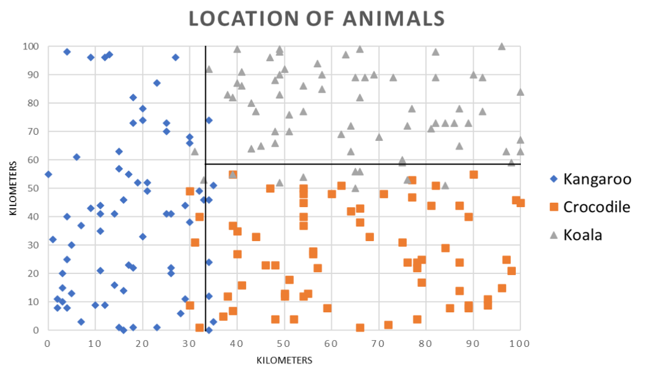
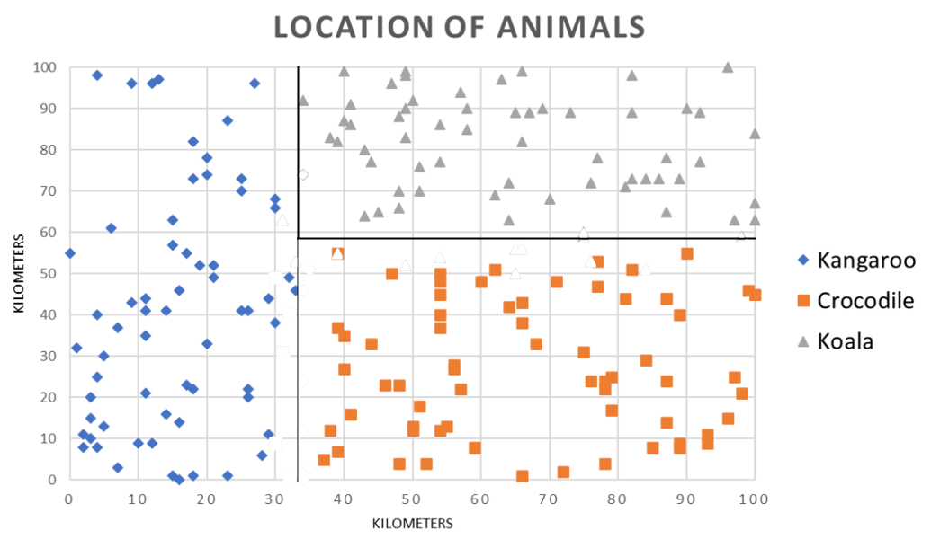
K-Means

Slide 41


Theft1
Read the pickle and dump the model, then do an offline evasion attack.
Threat model targets:
Trained Model
Inference process (Offline)
Inference process (Online)
MITRE Mapping:
ML Model Discovery
Model Replication
Offline Evasion
Model Stealing

Slide 42

Theft2
Keep trying decryption keys until the model decrypts then dump it.
Threat model targets:
Trained Model
Inference process (Offline)
Inference process (Online)
MITRE Mapping:
ML Model Discovery
Model Replication
Offline Evasion
Model Stealing

Slide 43
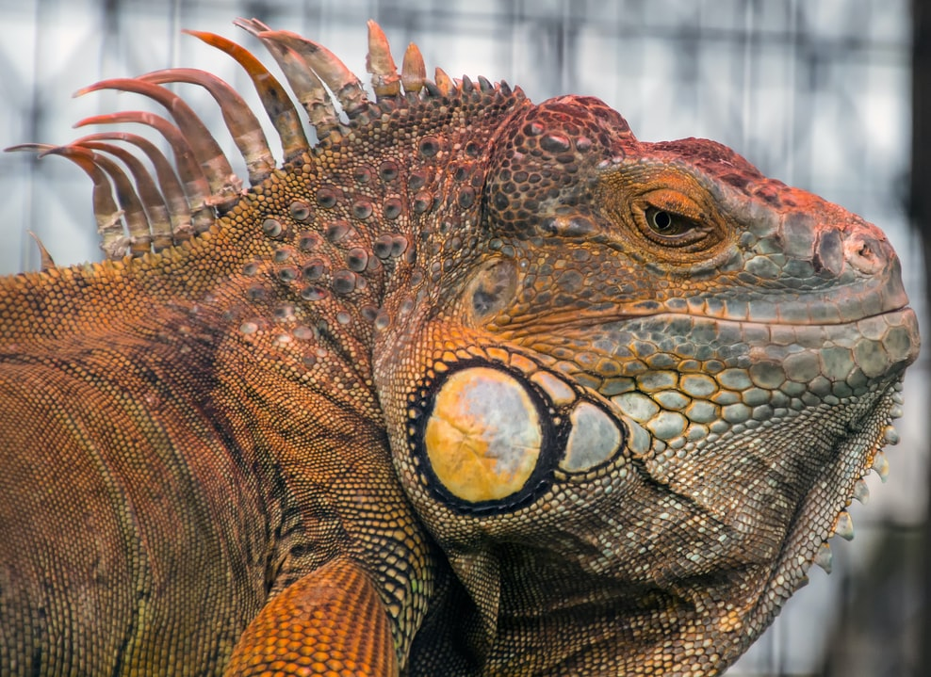
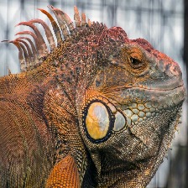
Theft3
Python variables in use are readable from a memory dump. The start bytes are static, I’m not too sure about the end bytes
I essentially just grep the start and end bytes of the pickle model.
Threat model targets:
Trained Model
Inference process (Offline)
Inference process (Online)
MITRE Mapping:
ML Model Discovery
Model Replication
Offline Evasion
Model Stealing

Slide 44
WAF
The waf checks sections of 5 characters. So use 4 malicious characters with an unknown beforehand and you can do a padding attack to find a bad char, then shift down one till you get the vulnerable string.
Then just use a WAF bypass and you have code exec ☺
Threat model targets:
Training Data
Inference process (Online)
MITRE Mapping:
ML Model Discovery
Exfiltrate Training Data
Online Evasion

Slide 45
Poison1
Corrupt the label of added data via ,1
http://127.0.0.1:5000/addpoison?data=BEES,1
Send this a whole lot and it will be labelled as class 1 not class 0
Threat model targets:
Training Data
Training Process
Trained Model
Inference Process (Online)
MITRE Mapping:
ML Model Discovery
Data Poisoning – Tainting Data from acquisition, Label Corruption
Defacement

Slide 46
Poison2
This one uses a quirk in this training configuration for this system. The tokenizer is built to match the dataset, not the model. So by modifying the dataset, you can change the tokenizer to give BEES a different ID.
Add BEES enough times without retraining the model and it will eventually swap ids with something with +50% confidence.
This is slightly prone to randomness so if it doesn’t work after 100+ requests just reset the dataset, retrain the model and try again.
Threat model targets:
Training Data
Training Process
Trained Model
Inference Process (Online)
MITRE Mapping:
ML Model Discovery
Data Poisoning – Tainting Data in training environment, Label Corruption
Denial of Service

Slide 47
Token
Using the same quirk as Poison 2 but more precisely, you need to find the two lines you can remove that will corrupt the labels exactly the right way such that BEES changes places with something with over 80% confidence
http://10.0.0.239:5000/checktoken?line1=493&line2=337
Threat model targets:
Training Data
Training Process
Trained Model
Inference Process (Online)
MITRE Mapping:
ML Model Discovery
Data Poisoning – Tainting Data in training environment, Label Corruption
Denial of Service

Slide 48
Shift
You can drift what the class’s average value is by adding more that are of the value you want.
Retrain the model till it has a high value (+40%), then add 15 of them at this value.
Then do this again until the model has a value of a higher value (+60%) then add 30 of them at this value. Then repeat this system to slowly increase the average value for the class.
Threat model targets:
Training Data
Training Process
Trained Model
Inference Process (Online)
MITRE Mapping:
ML Model Discovery
Model Poisoning
Defacement

Slide 49
Pickle
Pickles are unsafe by default, upload a malicious pickle and get code exec ☺
Threat model targets:
Training Process
MITRE Mapping:
Execute unsafe ML models

Slide 50
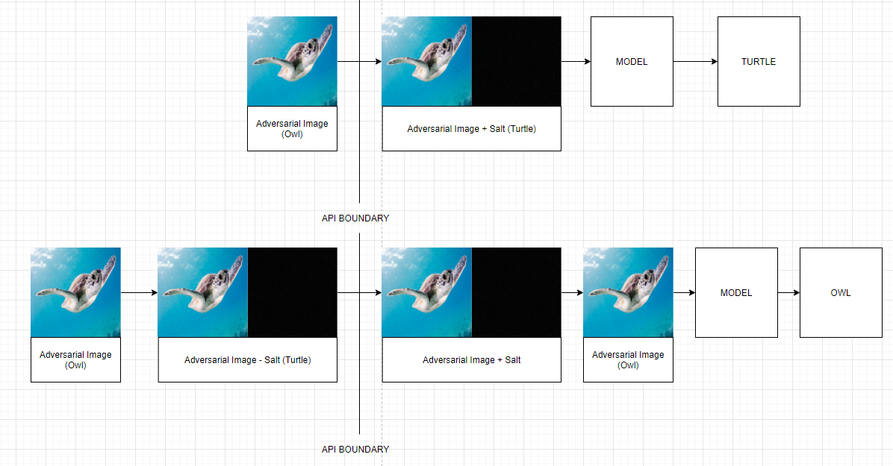
Salt 1
Since the salt is added to the image before classification, if you remove the salt from the image before classification, it will be back to normal for classification.
Threat model targets:
Trained Model
Inference process (Offline)
Inference process (Online)
MITRE Mapping:
ML Model Discovery
Model Replication
Offline Evasion
Model Stealing

Slide 51
Salt 2
Same as salt 2, Except because it uses a blurring function you need to prepare your image so it will be adversarial after blurring.
Technically blurring is a reversible process, so you should be able to predict it, but I couldn’t find an easy way, so I just sharpened the image, and then blurred it, and compared that to the original, tweaking pixels that needed it.
Threat model targets:
Trained Model
Inference process (Offline)
Inference process (Online)
MITRE Mapping:
ML Model Discovery
Model Replication
Offline Evasion
Model Stealing

Slide 52
Salt 3
By testing it against a number of random salts it both prevents the risk of the salt it adds fluking it into the right class and prevents the previous attacks from working.
However, the salts added to these images are actually quite small, you can add significantly more noise to the image, such that the noise it adds doesn’t even matter.
For a really tough challenge you can do this without overrunning their noise with your own noise.
I may make a harder version of this in the future where I also add noise detection to throw away images that are too noisy like my solution.
Threat model targets:
Trained Model
Inference process (Offline)
Inference process (Online)
MITRE Mapping:
ML Model Discovery
Model Replication
Offline Evasion
Model Stealing

